Slide 1
CS246: PageRank
Junghoo “John” Cho
UCLA

Slide 2
Problems of TFIDF
Q: Using TFIDF, what pages are likely to be returned for the query “Best Buy”?
TFIDF works well on small controlled corpus, but not on the Web
  Do users really want to see pages that contain the word “Best Buy” many times for the query Best Buy?
Easy to spam
  Ranking purely based on page content
  Authors can manipulate page content to get high ranking
Q: How can search engine figure out the pages that users truly have in mind?

Slide 3
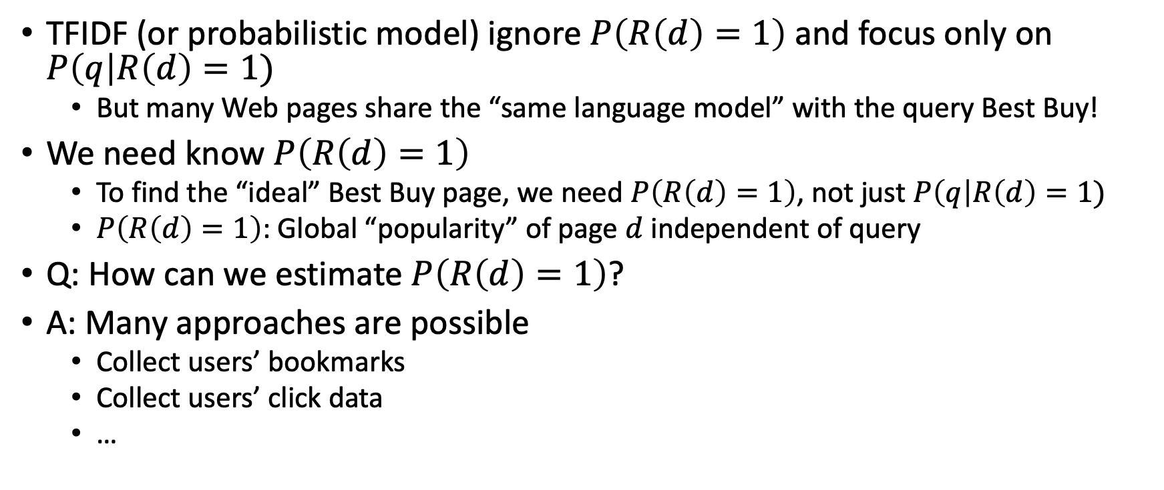
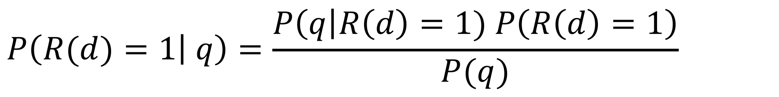
$$P\left(R(d)=1 | q\right)=\frac{P\left(q\right|R\left(d\right)=1) P\left(R\left(d\right)=1\right)}{P(q)}$$
TFIDF (or probabilistic model) ignore $P\left(R\left(d\right)=1\right)$ and focus only on $P\left(q\right|R\left(d\right)=1)$
  But many Web pages share the “same language model” with the query Best Buy!
We need know $P\left(R\left(d\right)=1\right)$
  To find the “ideal” Best Buy page, we need $P\left(R\left(d\right)=1\right)$, not just $P\left(q\right|R\left(d\right)=1)$
  $P\left(R\left(d\right)=1\right)$: Global “popularity” of page $d$ independent of query
Q: How can we estimate $P\left(R\left(d\right)=1\right)$?
A: Many approaches are possible
  Collect users’ bookmarks
  Collect users’ click data
  …

Slide 4
Link-Based Ranking
Basic idea
  People create a link to a page because they find the page useful
  Let us use “link structure” of the Web to measure a page’s popularity/quality
Example
  Many pages point to Best Buy home page with the anchor text “Best Buy”
Q: How can we use the link structure to measure page popularity?

Slide 5
Simple Link Count
Count the number of pages linking to the page
Unfortunately, this does not work well
  Too easy to spam: create many new pages and add link to a spam page
Q: Any way to avoid link spamming?

Slide 6
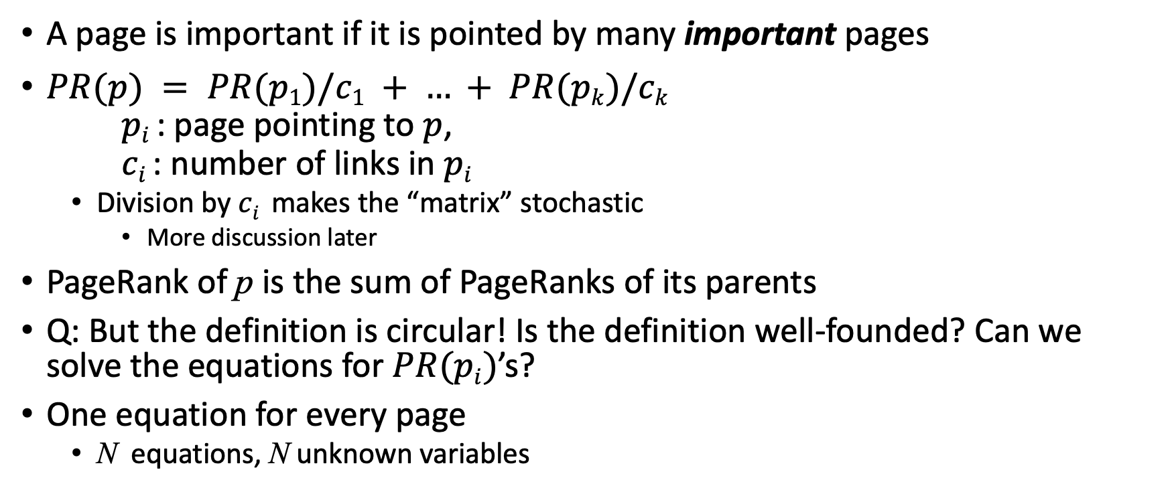
PageRank
A page is important if it is pointed by many important pages
$PR(p) = PR(p1)/c1 + … + PR(pk)/ck$
$pi$ : page pointing to $p$,
$ci$ : number of links in $pi$
  Division by $ci$ makes the “matrix” stochastic
    More discussion later
PageRank of p is the sum of PageRanks of its parents
Q: But the definition is circular! Is the definition well-founded? Can we solve the equations for $PR(pi)$’s?
One equation for every page
  N equations, N unknown variables

Slide 7

Example
Netflix, Microsoft and Amazon
PR(n) = PR(n)/2 + PR(a)/2
PR(m) = PR(a)/2
PR(a) = PR(n)/2 + PR(m)
Nf
MS
$$\left[\begin{matrix}n \\ m \\ a\end{matrix}\right]=\left[\begin{matrix}1/2 & 0 & 1/2 \\ 0 & 0 & 1/2 \\ 1/2 & 1 & 0\end{matrix}\right]\left[\begin{matrix}n \\ m \\ a\end{matrix}\right]$$
Am

Slide 8
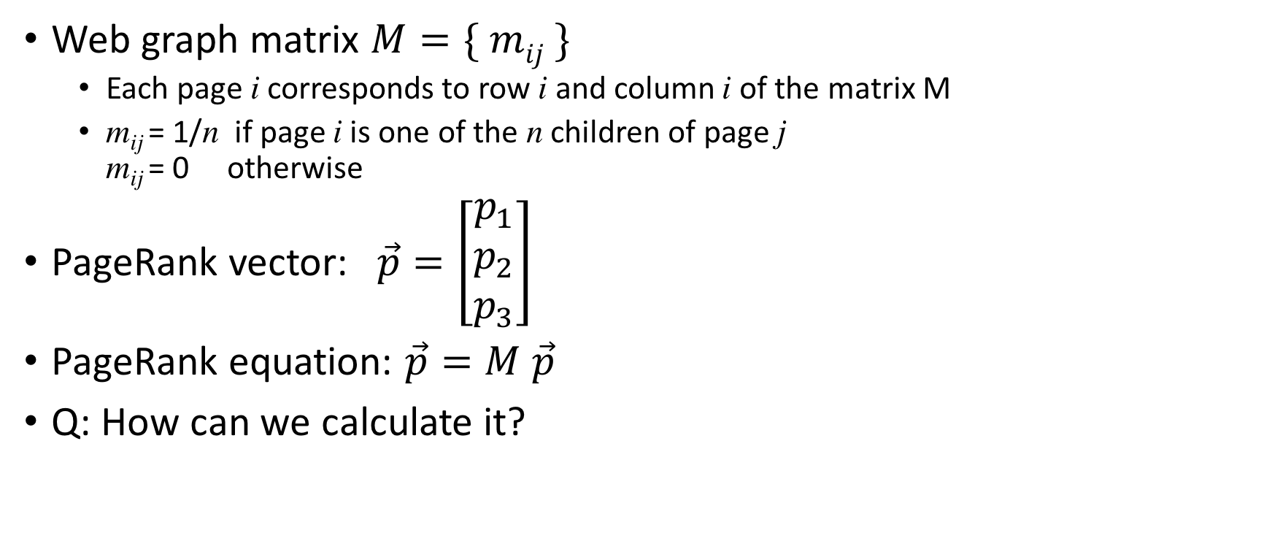
PageRank: Matrix Notation
Web graph matrix $M=\{ mij \}$
  Each page i corresponds to row i and column i of the matrix M
  m_{ij} = 1/n if page i is one of the n children of page j
  m_{ij} = 0 otherwise
PageRank vector:$\vec{p}=\left[\begin{matrix}p_{1} \\ p_{2} \\ p_{3}\end{matrix}\right]$
PageRank equation: $\vec{p}=M \vec{p}$
Q: How can we calculate it?

Slide 9
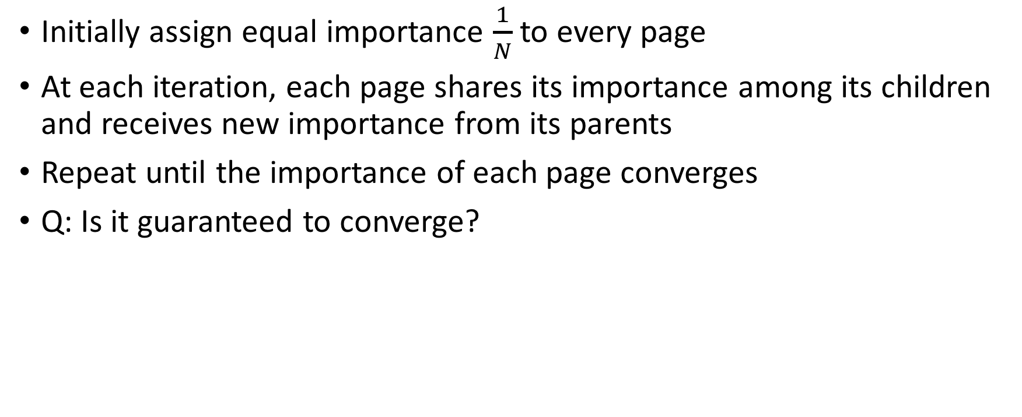
PageRank: Iterative Calculation
Initially assign equal importance $\frac{1}{N}$to every page
At each iteration, each page shares its importance among its children and receives new importance from its parents
Repeat until the importance of each page converges
Q: Is it guaranteed to converge?

Slide 10
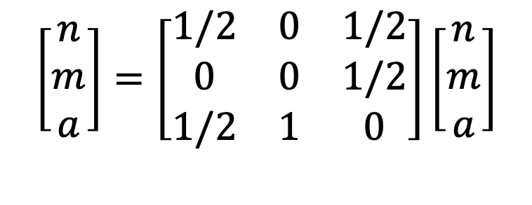
Example
$$\left[\begin{matrix}n \\ m \\ a\end{matrix}\right]=\left[\begin{matrix}1/2 & 0 & 1/2 \\ 0 & 0 & 1/2 \\ 1/2 & 1 & 0\end{matrix}\right]\left[\begin{matrix}n \\ m \\ a\end{matrix}\right]$$
Nf
MS
Am
Notes:
10

Slide 11

PageRank as Eigenvector
PageRank equation$:\vec{p}=M \vec{p}$
$\vec{p}$ is the principal eigenvector of M
  The principal eigenvalue of a stochastic matrix is 1

Slide 12
PageRank and Random Surfer Model
PageRank is he probability of a Web surfer to reach the page after many clicks, following random links
Random Click

Slide 13
Problems on the Real Web
Dead end
  A page with no links to send importance
  All importance “leaks out of” the Web
Crawler trap
  A group of one or more pages that have no links out of the group
  Accumulate all the importance of the Web

Slide 14

Example: Dead End
No link from Microsoft
Dead end
Nf
$$\left[\begin{matrix}n \\ m \\ a\end{matrix}\right]=\left[\begin{matrix}1/2 & 0 & 1/2 \\ 0 & 0 & 1/2 \\ 1/2 & 0 & 0\end{matrix}\right]\left[\begin{matrix}n \\ m \\ a\end{matrix}\right]$$
MS
Am

Slide 15

Example: Dead End
$$\left[\begin{matrix}n \\ m \\ a\end{matrix}\right]=\left[\begin{matrix}1/2 & 0 & 1/2 \\ 0 & 0 & 1/2 \\ 1/2 & 0 & 0\end{matrix}\right]\left[\begin{matrix}n \\ m \\ a\end{matrix}\right]$$
Nf
Q: How can we avoid the dead-end problem?
MS
Am
Notes:
15

Slide 16

Solution to Dead End
Option 1:
  Remove all dead end
  Q: Does it really solve the problem?
Option 2:
  Assume a surfer to jumps to a random page at a dead end
$$\left[\begin{matrix}n \\ m \\ a\end{matrix}\right]=\left[\begin{matrix}1/2 & 1/3 & 1/2 \\ 0 & 1/3 & 1/2 \\ 1/2 & 1/3 & 0\end{matrix}\right]\left[\begin{matrix}n \\ m \\ a\end{matrix}\right]$$
Nf
MS
Am

Slide 17

Example: Crawler Trap
Only self-link at Microsoft
Crawler trap
Nf
$$\left[\begin{matrix}n \\ m \\ a\end{matrix}\right]=\left[\begin{matrix}1/2 & 0 & 1/2 \\ 0 & 1 & 1/2 \\ 1/2 & 0 & 0\end{matrix}\right]\left[\begin{matrix}n \\ m \\ a\end{matrix}\right]$$
MS
Am

Slide 18
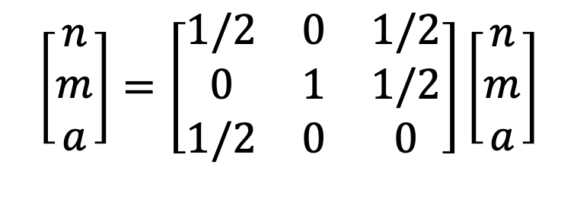
Example: Crawler Trap
$$\left[\begin{matrix}n \\ m \\ a\end{matrix}\right]=\left[\begin{matrix}1/2 & 0 & 1/2 \\ 0 & 1 & 1/2 \\ 1/2 & 0 & 0\end{matrix}\right]\left[\begin{matrix}n \\ m \\ a\end{matrix}\right]$$
Nf
MS
Am
Q: How can we avoid this problem?
Notes:
18

Slide 19
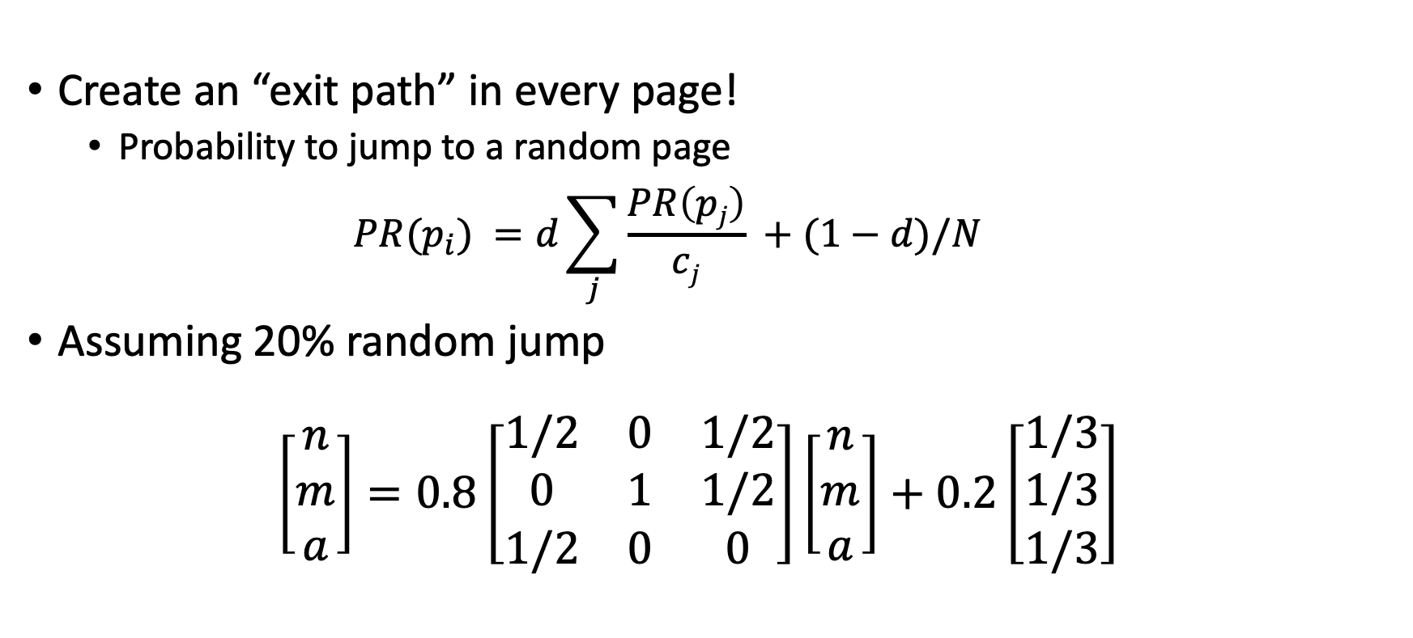
Crawler Trap: Damping Factor
Create an “exit path” in every page!
  Probability to jump to a random page
  $PR(p_{i}) =d\sum_{j}{\frac{PR\left(pj\right)}{cj}} +(1−d)/N$
Assuming 20% random jump
$\left[\begin{matrix}n \\ m \\ a\end{matrix}\right]=0.8\left[\begin{matrix}1/2 & 0 & 1/2 \\ 0 & 1 & 1/2 \\ 1/2 & 0 & 0\end{matrix}\right]\left[\begin{matrix}n \\ m \\ a\end{matrix}\right]+0.2\left[\begin{matrix}1/3 \\ 1/3 \\ 1/3\end{matrix}\right]$

Slide 20
Crawler Trap: Damping Factor
Random surfer interpretation
  A surfer gets “bored” after a few clicks and randomly jumps to another page
Damping factor makes the graph a fully-connected graph
  Ensures convergence from iterative computation method

Slide 21
Link-Spam Problem
Q: What if a spammer creates a lot of pages and create a link to a single spam page?
  PageRank better than simple link count, but still vulnerable to link spam
Q: Any way to avoid link spam?

Slide 22
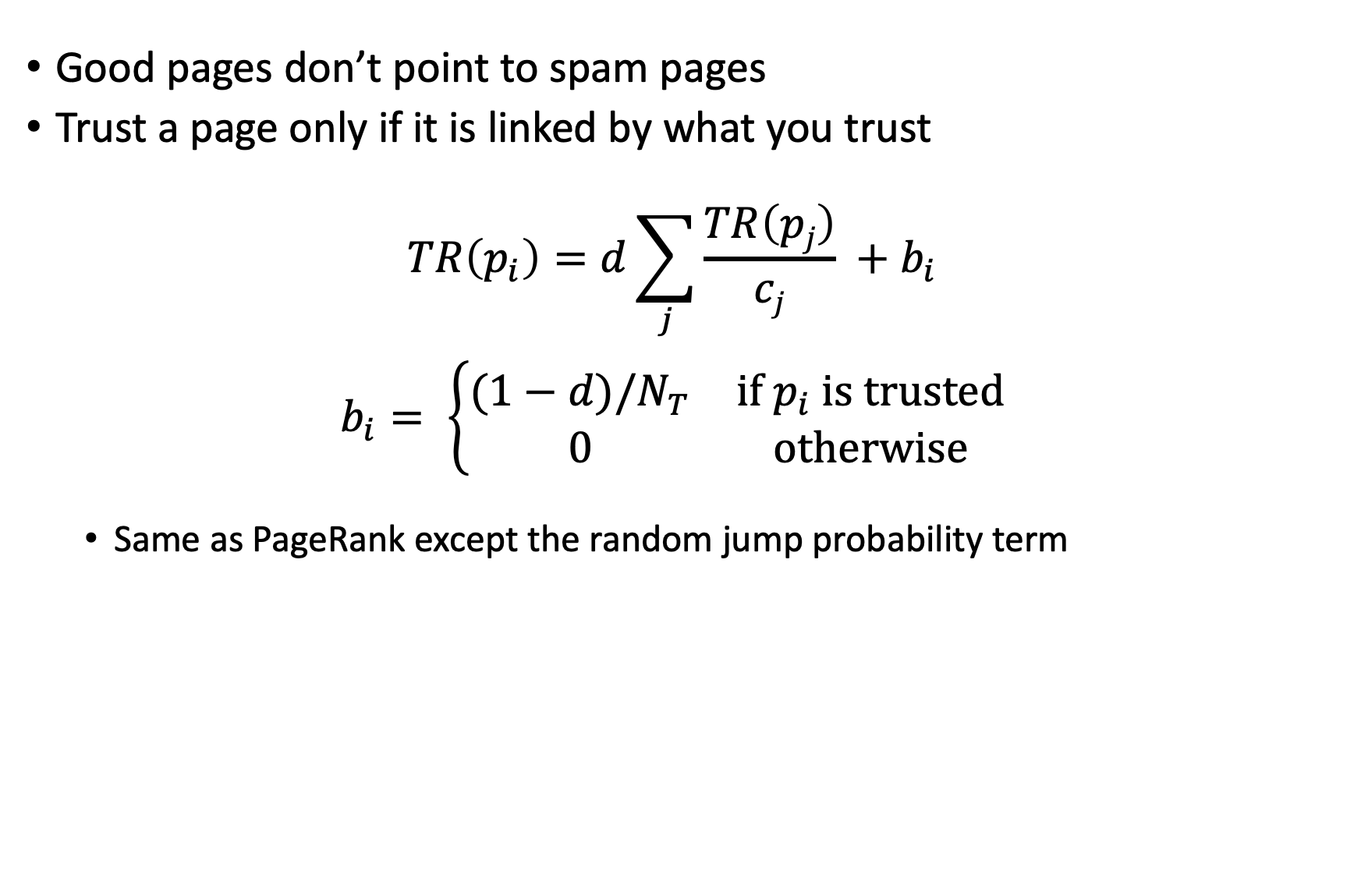
TrustRank [Gyongyi et al. 2004]
Good pages don’t point to spam pages
Trust a page only if it is linked by what you trust
$TR\left(p_{i}\right)=d\sum_{j}{\frac{TR\left(pj\right)}{cj}} +b_{i}$
$b_{i}= \left\{\begin{matrix}(1−d)/N_{T} & if p_{i} is trusted \\ 0 & otherwise\end{matrix}\right.$
  Same as PageRank except the random jump probability term

Slide 23
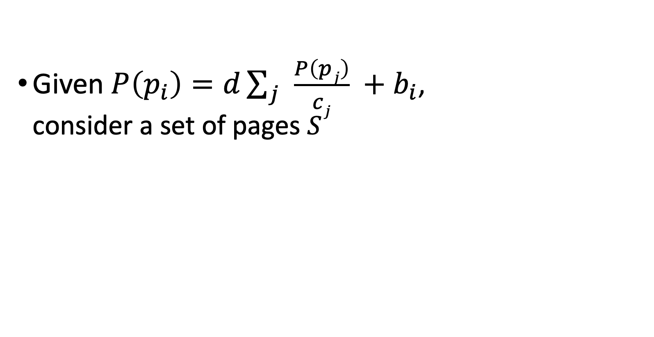
TrustRank: Theory [Bianchini et al. 2005]
Given $P\left(p_{i}\right)=d\sum_{j}{\frac{P\left(pj\right)}{cj}} +b_{i}$,
consider a set of pages $S$
S
IN(S)
OUT(S)
DP(S)

Slide 24
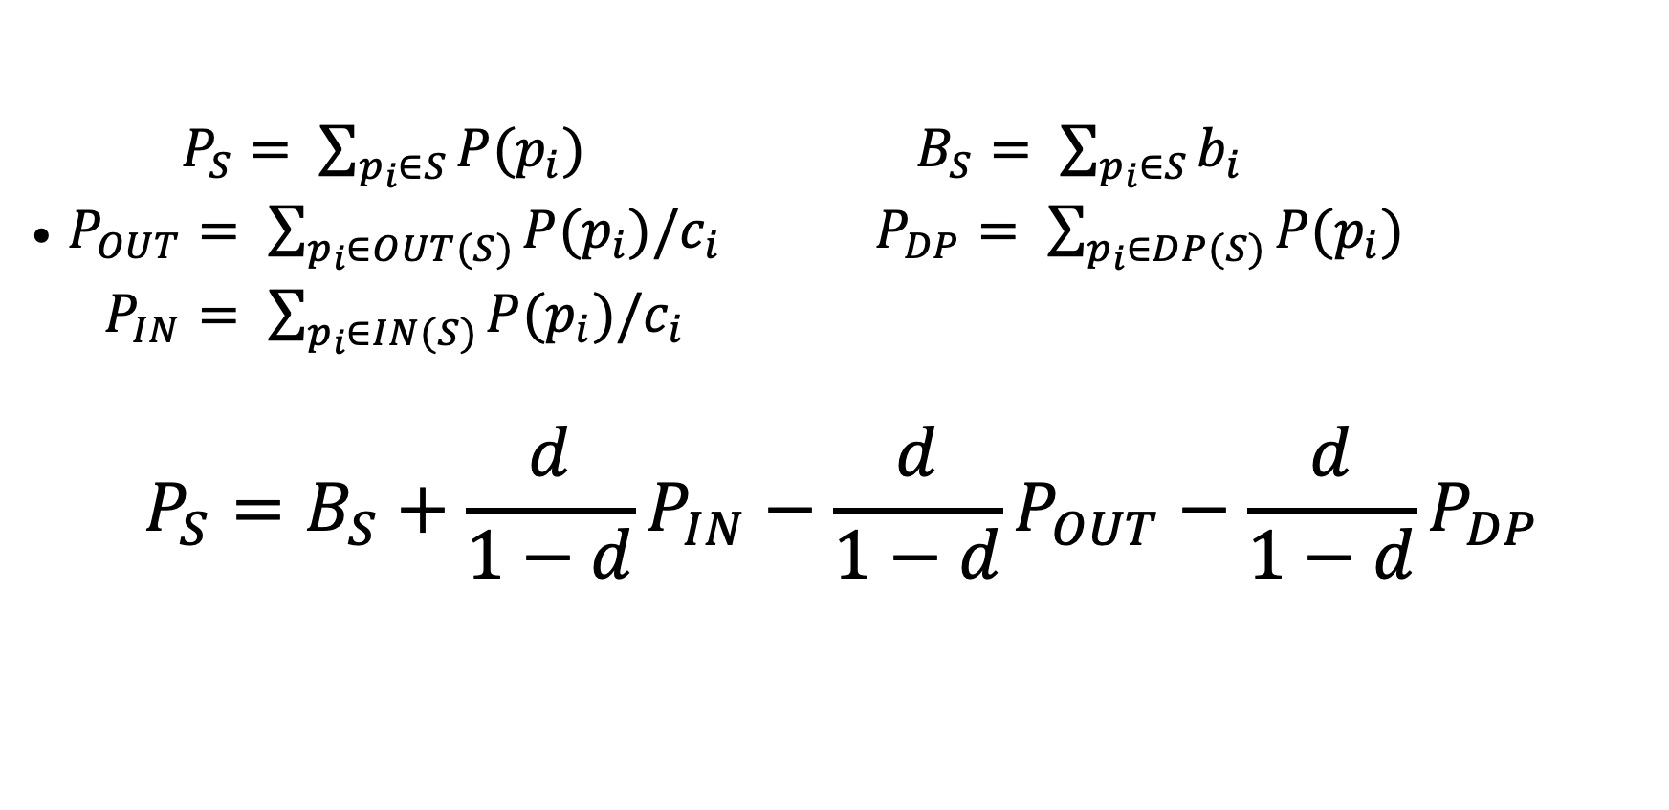
TrustRank: Theory [Bianchini et al. 2005]
$\begin{matrix}P_{S}= \sum_{p_{i}∈S}{P(p_{i})} & B_{S}= \sum_{p_{i}∈S}{b_{i}} \\ P_{OUT}= \sum_{p_{i}∈OUT(S)}{P(p_{i})/c_{i}} & P_{DP}= \sum_{p_{i}∈DP(S)}{P(p_{i})} \\ P_{IN}= \sum_{p_{i}∈IN(S)}{P(p_{i})/c_{i}} & \end{matrix}$
$$P_{S}=B_{S}+\frac{d}{1−d}P_{IN}−\frac{d}{1−d}P_{OUT}−\frac{d}{1−d}P_{DP}$$

Slide 25
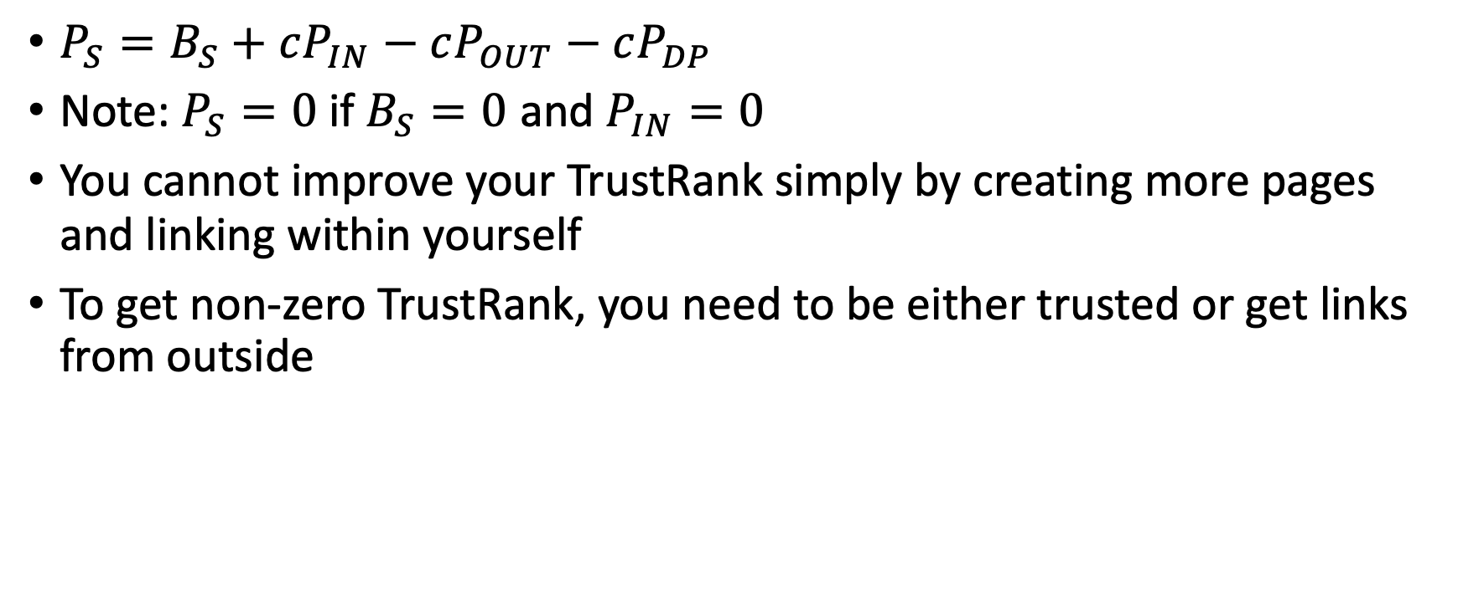
What Does It Mean?
$P_{S}=B_{S}+cP_{IN}−cP_{OUT}−cP_{DP}$
Note: $P_{S}=0$if $B_{S}=0$ and $P_{IN}=0$
You cannot improve your TrustRank simply by creating more pages and linking within yourself
To get non-zero TrustRank, you need to be either trusted or get links from outside

Slide 26
Is TrustRank the Ultimate Solution?
Not really…
  Honeypot: A page with good content with hidden links to spams
    Good users link to honeypot due to its quality content
  Blogs, forums, wikis, mailing lists
    Easy to add spam links
  Link exchange
    Set of sites exchanging links to boost ranking
A never-ending rat race…

Slide 27
References
[Gyongyi et al. 2004] Z. Gyöngyi, H. Garcia-Molina, J. Pedersen: Combating Web Spam with TrustRank, VLDB Conference 2004
[Bianchini et al. 2005] Monica Bianchini, Marco Gori, and Franco Scarselli: Inside PageRank, ACM Transactions on Internet Technology 5(1), February 2005

